Slide 1
What is Agile Model

Slide 2
Agile model based on models
Incremental
Iterative

Slide 3
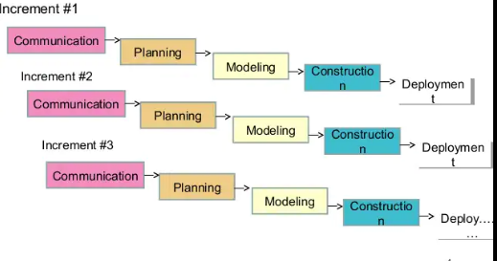
Incremental SDLC

Slide 4
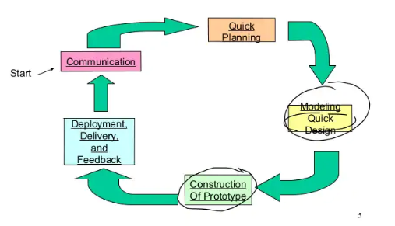
Prototype SDLC

Slide 5
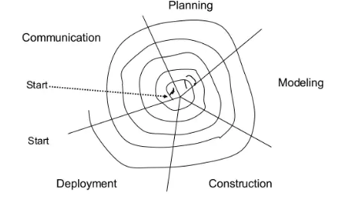
Spiral SDLC

Slide 6
What is agility?
Effective response to the change

Slide 7
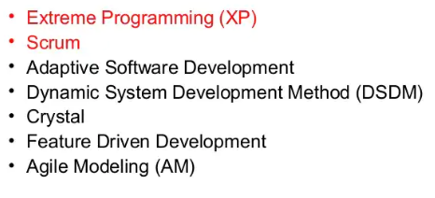
Approaches

Slide 8
Phases of Agile Model:
Requirements gathering
Design the requirements
Construction/ iteration
Testing/ Quality assurance
Deployment
Feedback

Slide 9
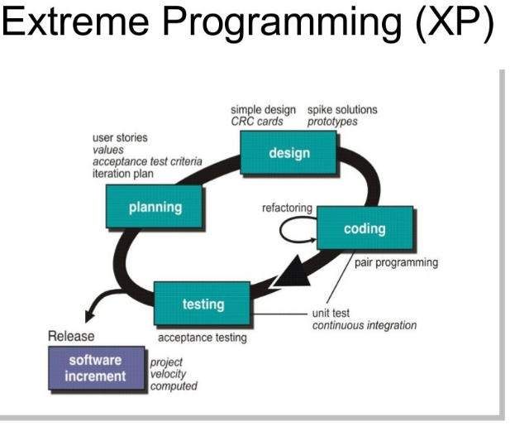

Slide 10
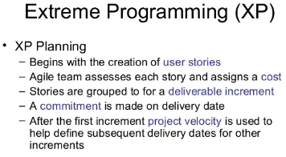

Slide 11
User Stories
A user story is the smallest unit of work in an agile framework.
It's an end goal, not a feature, expressed from the software user's perspective.
A user story is an informal, general explanation of a software feature written from the perspective of the end user or customer.

Slide 12
What should a good user story look like?
User stories are basically written from the users
Viewpoint, and capture the 'who', 'what' and 'why' of a requirement.
A user story should be short and concise, so that its contents can fit on an index card.
A finished user story can then be integrated into the product backlog and prioritized

Slide 13
User story features (3C’s)
The first C is the user story in its raw form, the Card.
The second C is the Conversation.
The third C is the Confirmation.

Slide 14
User stories are often expressed as
persona + need + purpose
Format:
"As a [persona], I [want to ...], so that [...]"

Slide 15
User stories are often expressed as
"As a [persona], I [want to ...], so that [...]“
"As a user, I want to be able to securely log in to the system so that my information can only be accessed by me."

Slide 16
Acceptance Criteria
The acceptance criteria determine the specific conditions that the software product must satisfy to be accepted by and meet the expectations of the user. It also forms the basis for the acceptance testing stage.
During the refinement process, as larger user stories become epics and are broken down into smaller scoped user stories,

Slide 17
Some guiding principles for acceptance criteria
Each acceptance criterion should be independently testable
Each acceptance criterion test should have a clear pass/fail result
Acceptance criteria should be focused on the end result
(functionality), not the mechanism through which it is achieved
When relevant, "hidden" non-functional criteria should be included

Slide 18
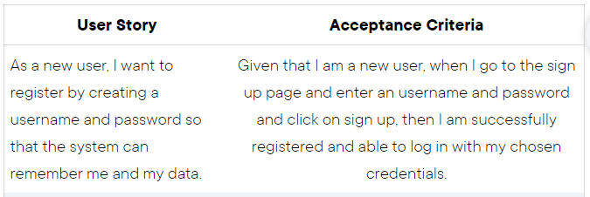
Acceptance criterion expressed as
"Given [precondition], when I [do some action] then I expect [result]”
Example

Slide 19
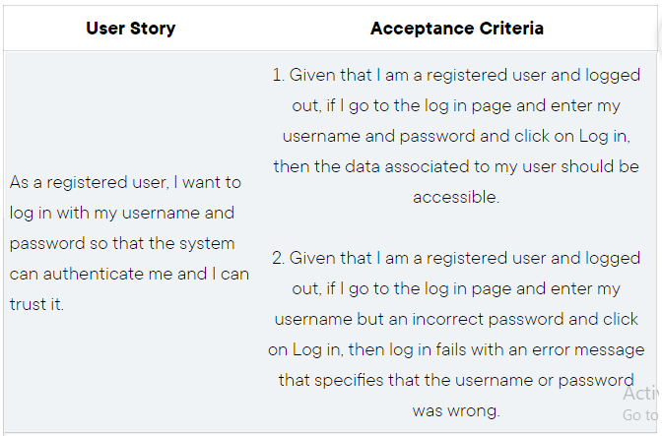

Slide 20
Design
Design provides implementation guidance for a story as it is written
Nothing less, nothing more
The design of extra functionality is discouraged
XP design rigorously follows the KIS (keep it simple) principle

Slide 21
Design
XP encourages the use of CRC cards as an effective mechanism
Class-responsibility-collaborator (CRC)
The CRC cards are the only design work product produced as part of the XP process.

Slide 22
CRC (Class, Responsibilities, Collaborators)
CRC card approach is a design and analysis approach to help us in analysis design phrase in software development life cycle
CRC cards are an activity bridging the worlds of role-playing games and object-oriented design
Normally, CRC is a significant program written in an object oriented language like Java is divided into several different classes.
The aim of using CRC is to discover the real world objects is a system and map the collaboration among classes and their responsibilities.

Slide 23
CRC (Class, Responsibilities, Collaborators)
CRC benefits any software development team because it takes advantage of the teamwork where this approach mainly through
Brainstorming
Role-playing
Problem solving interaction

Slide 24
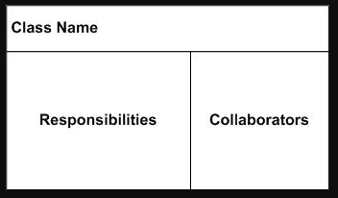
CRC (Class, Responsibilities, Collaborators)
CRC is divided into 3 main areas:
class name
responsibilities
collaborators in the front of the card.
Card is part of hierarchy: superclass or subclasses can be written below the class name.
Class depends on other classes to carry out responsibilities: collaborators written by side the responsibility
Note that every card will have a class name and at least one

Slide 25
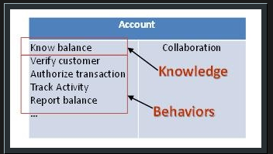
CRC (Class, Responsibilities, Collaborators)
After identifying a set of core classes First, we must identify the types of responsibilities
are we looking for in each class: Behavior Describes how a class does things that meet the
requirements of the system.
Knowledge Describes the way in which a class will function by supplying information about itself.
An example that illustrate the two types of responsibilities are shown in the CRC card.

Slide 26
CRC Modeling (Assignment)
Attributes and class definitions can be written at the back of the card.
There are 6 steps in CRC card model:
Discovering Candidate Classes
Clarifying the Scope
Selecting Core Classes
Assigning Responsibilities
Assigning Collaborators
Identifying Hierarchy

Slide 27
Benefits of CRC
Definition. CRC cards (for Class, Responsibilities, Collaborators) are an activity bridging the worlds of role-playing games and object-oriented design
They are
Portable
Tangible
limited size

Slide 28
Design
Two approaches
Spike Solution
Refactoring

Slide 29
Spike Solution
For difficult design portion recommends the immediate creation of an operational prototype of that portion
When the intent is to lower risk then true implementation starts
Then validate the original estimates for the story containing the design problem

Slide 30
Refactoring
The process of changing a software system in such a way that it does
Don’t alter the external behavior of the code
Yet improves the internal structure.
Disciplined way to clean up code and modify/simplify
Minimizes the chances of introducing bugs
Improving the design of the code after it has been written
Design occurs both before and after coding commence

Slide 31
Coding
The team does not move to code, but rather develops a series of unit tests
Develops a series of unit tests that will
Exercise each of the stories that is to be included in the current release (software increment)
Once the unit test has been created, the developer is better able to focus on what must be implemented to pass the test.
Nothing extraneous is added

Slide 32
Coding
Pair programming
One person might think about the coding details of a particular portion of the design
Other ensures that coding standards
unit test that has been developed to validate the code against the story. 7
As pair programmers complete their work, the code they develop is integrated
with the work of others.
In some cases this is performed on a daily basis
In other cases, the pair programmers have integration responsibility.

